Slide 1
Revelation 14

Slide 2
Revelation 14:9-11 (1 / 3)
Question
Could the Saints get away with bowing the knee to the beast (Caesar) in order to receive a certificate of worship, get forgiveness, continue worshipping God and still go to Heaven?
Revelation 14:9-11
⁹ And the third angel followed them, saying with a loud voice, If any man worship the beast and his image, and receive his mark in his forehead, or in his hand,
¹⁰ The same shall drink of the wine of the wrath of God, which is poured out without mixture into the cup of his indignation; and he shall be tormented with fire and brimstone in the presence of the holy angels, and in the presence of the Lamb.
¹¹ And the smoke of their torment ascends up for ever and ever: and they have no rest day nor night, who worship the beast and his image, and whosoever receives the mark of his name.
Notes:
If anyone worships the beast, they will “receive his mark:
That person will drink of wine of wrath of God undiluted
Smoke of their torment ascends for ever
No rest
Vs 9-10 - Bow to “beast” = receiving wrath of God
Vs 10 – “without mixture” – Greek work actually means “undiluted”; not mixed with anything else to lessen its strength

Slide 3
Revelation 20:4 (2 / 3)
Question
Could the Saints get away with bowing the knee to the beast (Caesar) in order to receive a certificate of worship, get forgiveness, continue worshipping God and still go to Heaven?
Revelation 20:4
⁴ . . . and I saw the souls of them that were beheaded for the witness of Jesus, and for the word of God, and which had not worshipped the beast, . . .
Notes:
Rev 20:4 – Souls of the saints beneath the alter before the throne of God had not worshipped the beast
Answer appears to be “No”

Slide 4
Revelation 14:5 (3 / 3)
Question
Could the Saints get away with bowing the knee to the beast (Caesar) in order to receive a certificate of worship, get forgiveness, continue worshipping God and still go to Heaven?
Revelation 14:5
And in their mouth was found no guile; for they are without fault before the throne of God.
Guile
ψεῦδος (pseudos) – Rev #5579
7x in N.T. (3x in Rev)
Falsehood, untruth, lie, false religion, duplicity
Duplicity - to have a situation “both ways”
Notes:
3x in Rev:
Rev 14:5
Rev 21:27
Rev 22:15
Saints were “walking in the light”

Slide 5
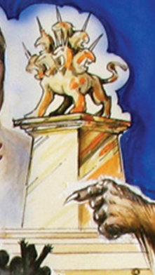
Revelation 14:9-11 - Image to the Beast
Honors Beast #1
Beast #2 “gave life” to Image
Ordered people to:
Worship Beast #1
Be killed if they refused
Possible to worship “image”
Perhaps a literal idol(s)
Revelation 14:11
¹¹ And the smoke of their torment ascends up for ever and ever: and they have no rest day nor night, who worship the beast and his image, and whosoever receives the mark of his name.
Notes:
Rev 14:9-11
¹¹ And the smoke of their torment ascends up for ever and ever: and they have no rest day nor night, who worship the beast and his image, and whosoever receives the mark of his name.
Perhaps the “Image” was an idol of Beast #1 along with a law to worship it.
Buddhist countries place idols to Buddha all throughout their cities.
It was “given life” by military force to worship it.

Slide 6
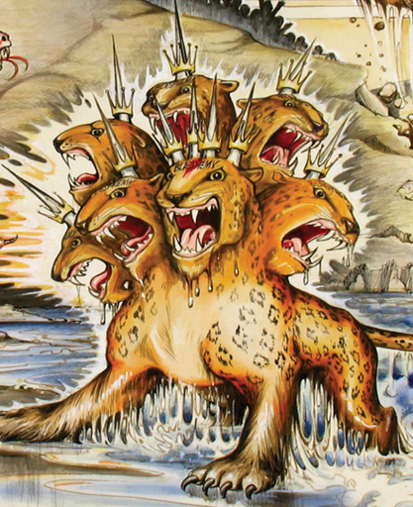
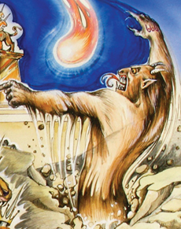
Revelation 13: Solution
Beast #1
Image to Beast
Beast #2
Rome led
By Caesars
Law to worship Caesar
& Literal Idol
Military
and Governors
Notes:
Thailand does same thing with Buddha statues all over the country.
We know Domitian wanted to be addressed as “Lord and God”.

Slide 7
“The Roman Cult Of Emperor Worship”
https://readingacts.com/2010/04/02/the-roman-cult-of-emperor-worship/
Julius Caesar allowed himself to be worshiped as a god, but his successor Augustus only allowed emperor worship outside of the city of Rome. Augustus is known in some inscriptions as CAESAR DIVI FILIUS, Son of God, that is, Son of eternal Caesar. Oaths were taken on the divine spirit of the emperor. His image was publicly adored. Worship of the image was a regular military duty. Caligula was the first emperor to demand to be worshiped, he demanded that citizens everywhere bow to his statue. Nero also claimed to be divine, although in neither case was there a requirement to worship the emperor. As Augustus had been Zeus incarnate, so Nero was Apollo incarnate. Even Seneca called him as the long-awaited savior of the world.
Domitian took the title "lord and god" and ordered people to confess he was "lord and god" as a test of loyalty (Suetonius, The Lives of the Caesars, Book 8: Domitian 13).
Notes:
https://readingacts.com/2010/04/02/the-roman-cult-of-emperor-worship/

Slide 8
“The Roman Cult Of Emperor Worship”
Marital says the "beasts in the arena" hailed him as a god. While this is clearly legendary, it does reflect a contemporary writer implying divine honors for Domitian. Dio Cassius (Roman History 67.14) refers to Domitian exiling a Flavius Clemens and his wife, Flavia Domitilla for "atheism". Atheism is the charge made against those who drifted into "things Jewish". Dio Chrysostom (40 – 115 AD, Greek orator, writer, philosopher, and historian) reported that Domitian liked to "be flattered" as "master and god". Those who refused to flatter him in this way risked trouble. (In Oratorio 45:1, see also First Discourse on Kingship, 1.14-15).
How prevalent was the imperial cult in Asia Minor? Of the seven cities mentioned in Revelation 2-3, five have imperial priests and altars (all but Philadelphia and Laodicea) and six have imperial temples (all but Thyatira). At Pergamum, an imperial temple was established as early as 28 B.C. The city was so central to the imperial cult that Revelation describes this city as having the "throne of Satan". In short, a Christian in Asia Minor could not avoid the Imperial Cult.
Notes:
https://readingacts.com/2010/04/02/the-roman-cult-of-emperor-worship/

Slide 9
“The Roman Cult Of Emperor Worship”
It was during the reign of Domitian when the imperial cult became a factor in unifying the empire in Asia Minor. The provincial cult allowed the Roman network of social obligations to be extended to virtually the whole population. If you lived within the empire, then you were a social client of the Emperor and owed him supreme allegiance. It is not hard to see, therefore, the struggle which Christians in the late first century would have showing allegiance to Rome - if that allegiance required worship of the Emperor, then the Christian must refuse or compromise their faith.
https://readingacts.com/2010/04/02/the-roman-cult-of-emperor-worship/
Notes:
https://readingacts.com/2010/04/02/the-roman-cult-of-emperor-worship/

Slide 10
Revelation 14:6
⁶ And I saw another angel fly in the midst of heaven, having the everlasting gospel to preach unto them that dwell on the earth, and to every nation, and kindred, and tongue, and people,
Matt
Mark
Acts
Romans
1 Cor
2 Cor
Gal
εὐαγγέλιον (euangelion) - Ref #2098
41x in N.T.
“gospel”
Literally: “God’s good news”
Entire Bible
Not limited to how a person becomes a Christian
Eph
Phil
1 Thess
1 Tim
2 Tim
Rev
- 4x
- 4x
- 1x
- 7x
- 4x
- 5x
- 5x
- 1x
- 2x
- 5x
- 1x
- 1x
- 1x
¹ biblehub.com
Notes:
Vs 6
Word “gospel” used
When Revelation wants to refer to the gospel, it uses the word gospel in Greek
Rev 5 – that is why the scroll with 7 seals is not translated as gospel
Don’t force Revelation to say something that it is not saying
History will usually keep you out of trouble
When Revelation means “gospel”, it says “gospel”

Slide 11
Revelation 14:8
⁸ And there followed another angel, saying, Babylon is fallen, is fallen, that great city, because she made all nations drink of the wine of the wrath of her fornication.
Fornication - 12x
Rev 2:14 (1x - literal?)
Rev 2:20 (1x - literal?)
Rev 2:21 (1x - literal?)
Rev 9:21 (1x - literal)
Rev 14:8 (1x - figurative)
Rev 17:2 (2x - figurative)
Rev 17:4 (1x - figurative)
Rev 18:3 (2x - figurative)
Rev 18:9 (1x - figurative)
Rev 19:2 (1x - figurative)
“made”
πεπότικεν (pepotiken)
Ref #4222 ¹
1x in N.T.
“to cause to drink”
“to give to drink”
(No force implied)
¹ biblehub.com
Notes:
Preview of coming attractions:
To Cause – in this case, “made” does not mean to force.
Babylon – evil city to represent villain of Revelation
“Fornication” used 12x in Revelation
Rev 14:8 – “because she made all nations drink the wine of the wrath of her fornication.”
“she” = villain of Revelation
Will see same imagery and accusation in chapters 17 and 18
* CRITICAL *
Villain’s accomplices will pay a price for enabling villain
Accomplices will be punished, too
This theme is coming back in chapters 17 - 18

Slide 12
Revelation 14:14; 16 - “With Clouds”
¹⁴ And I looked, and behold a white cloud, and upon the cloud one sat like unto the Son of man, having on his head a golden crown, and in his hand a sharp sickle.
¹⁶ And he that sat on the cloud thrust in his sickle on the earth; and the earth was reaped.
Revelation 1:7
¹⁷ Behold, he comes with clouds; and every eye shall see him, and they also which pierced him: and all kindreds of the earth shall wail because of him. Even so, Amen.
Mark 13:26; 32
²⁶ And then shall they see the Son of man coming in the clouds with great power and glory.
³² But of that day and that hour knows no man, no, not the angels which are in heaven, neither the Son, but the Father.
Notes:
Jesus receiving his faithful, and the disposition of Evil is compared to reaping a harvest
Son of Man sitting on a white cloud
It will not be a cloudless morning
Depiction of judgment day; judgment day is not actually happening in Revelation
Armageddon has not even happened
Chapters 17, 18, and 19 have not happened

Slide 13
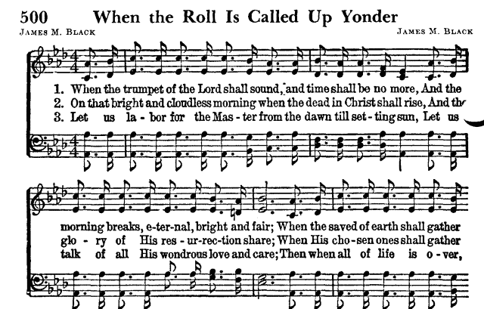
Notes:
On that bright and “joyous” morning . . .
Poetic license:
Jesus , Rose of Sharon, bloom within my heart
He’s the Lily of the Valley, the Bright and Morning Star
Fairest of 10,000 to my soul

Slide 14
Revelation 14:19-20
¹⁹ And the angel thrust in his sickle into the earth, and gathered the vine of the earth, and cast it into the great winepress of the wrath of God. ²⁰ And the winepress was trodden without the city, and blood came out of the winepress, even unto the horse bridles, by the space of a thousand and six hundred furlongs [stadia].
Stadia is better translation
Metaphor
Compares judgment of evil to a winepress
Compares grape juice to blood of evil people
See Revelation Characteristic:
“Characteristic – 1600 Furlongs”
Notes:
Interesting metaphor

